Slide 1
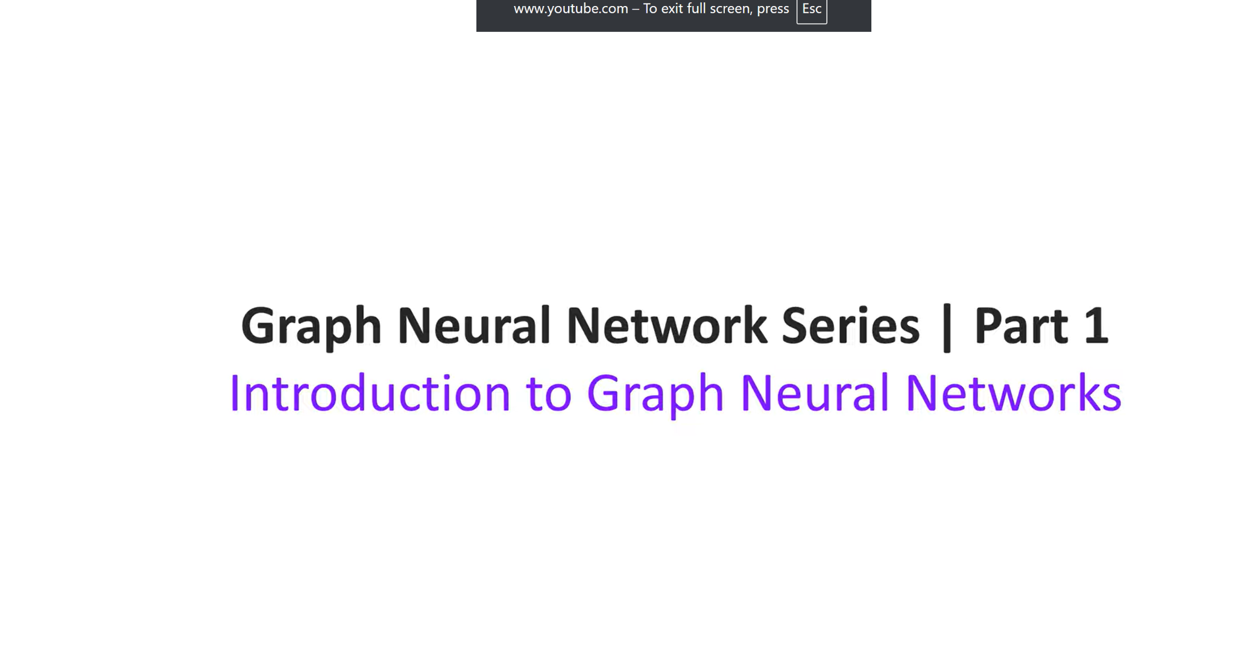
GNN - GCN
Notes:
Introduction to Graph Neural Networks
Introduction to Graph Neural Networks
Adjacency matrix represents the connections in a graph

Slide 2
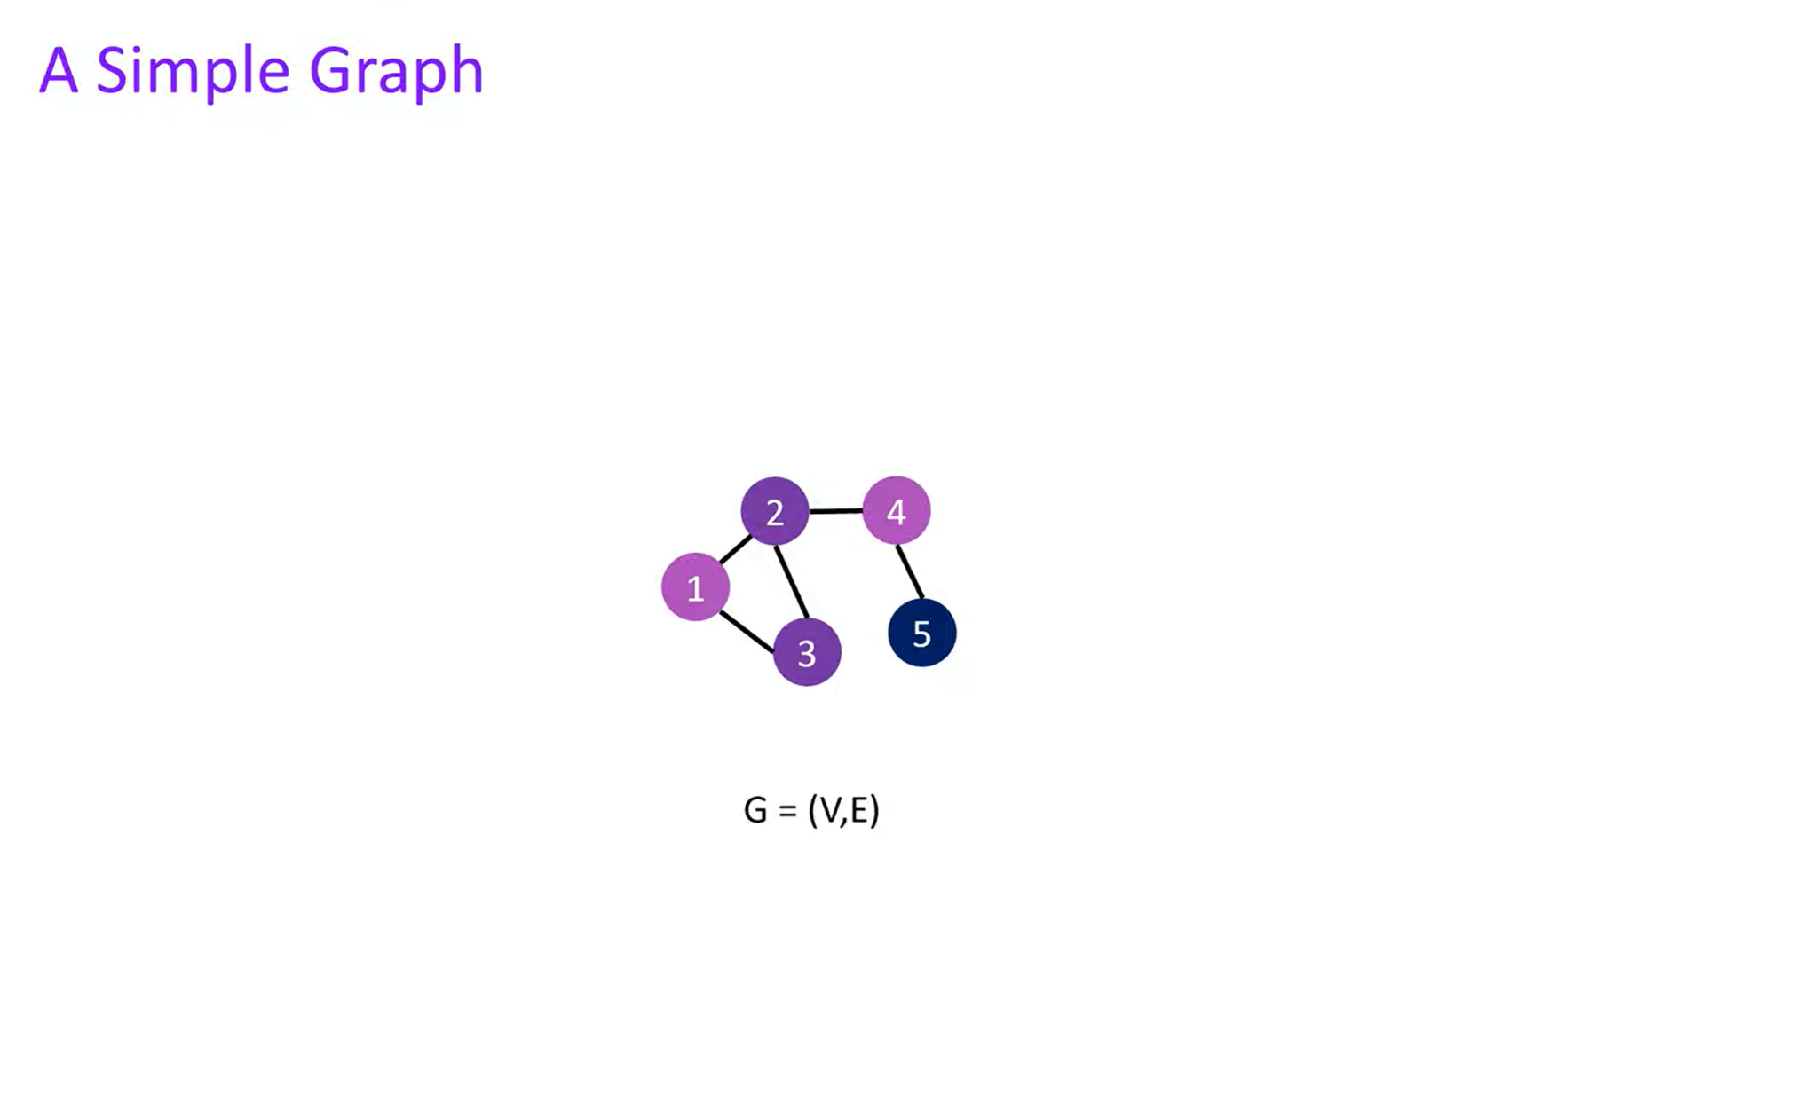
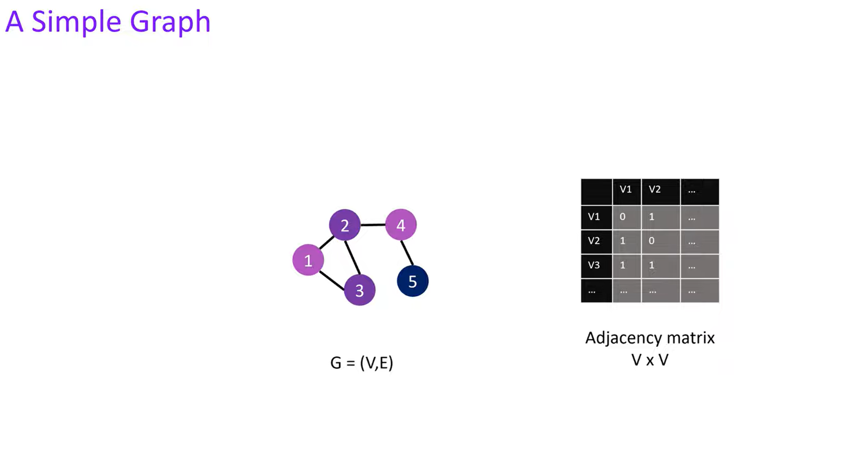
GNN
Add content here onwards
Notes:
Graphs consist of nodes and connections called edges
Adjacency matrix represents the connections in a graph

Slide 3
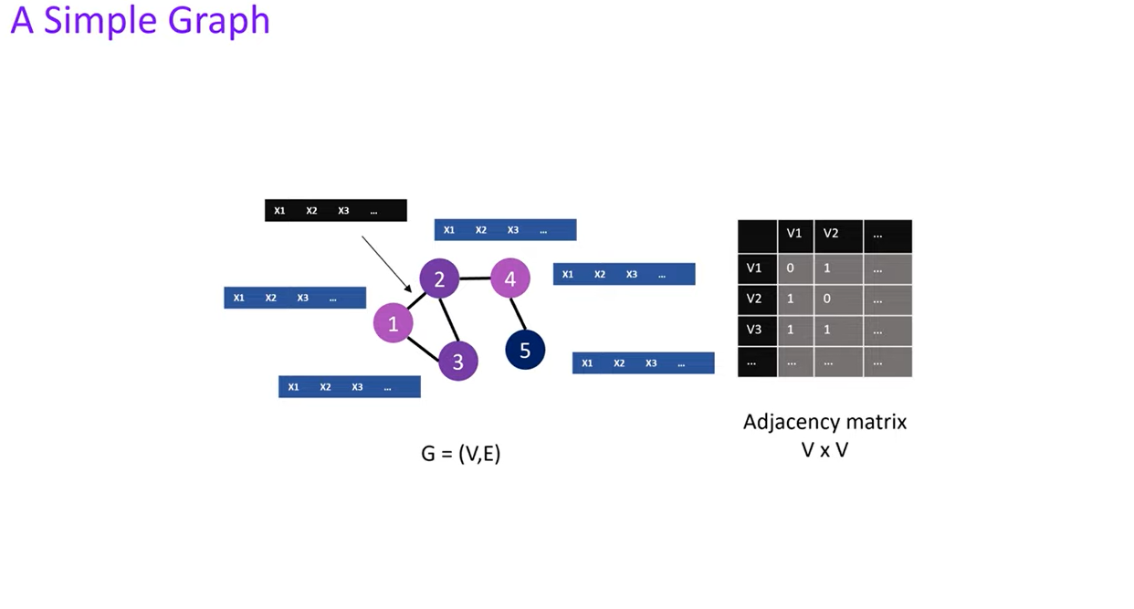
GCN
Notes:
Graphs are used to represent structures like molecules and social networks.
The node features in a graph can represent attributes like atom type or number of protons.
The edge features in a graph can represent additional information like bond type.

Slide 4
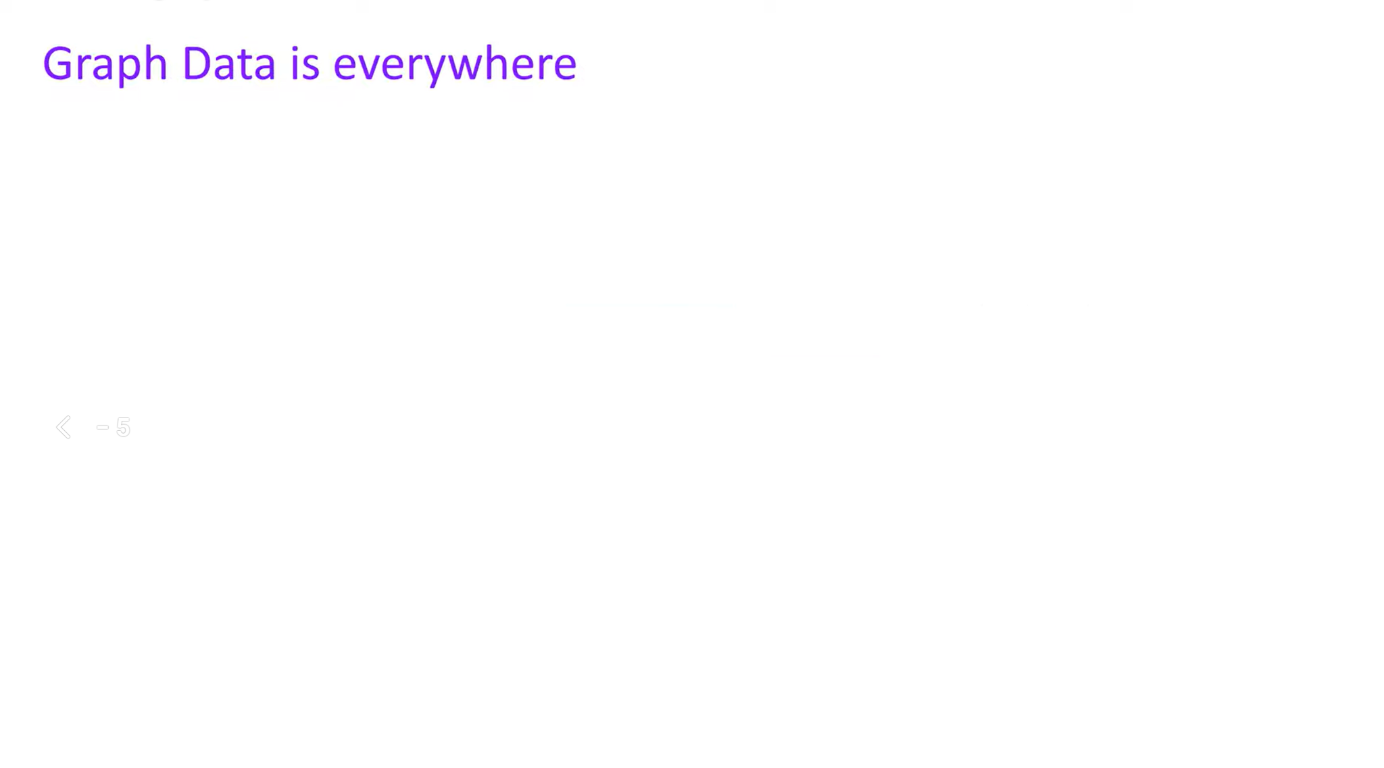
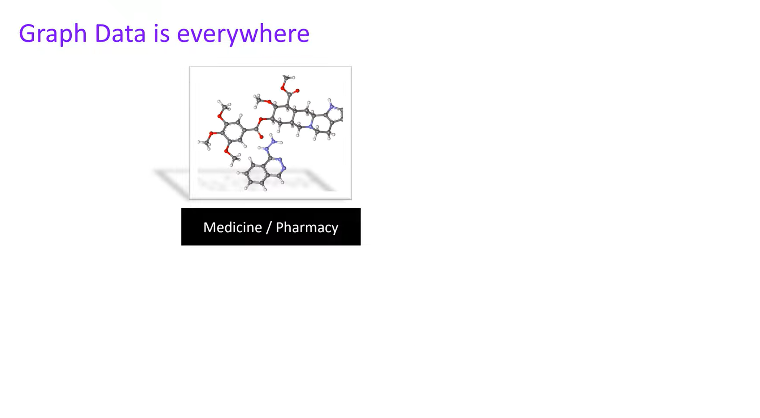
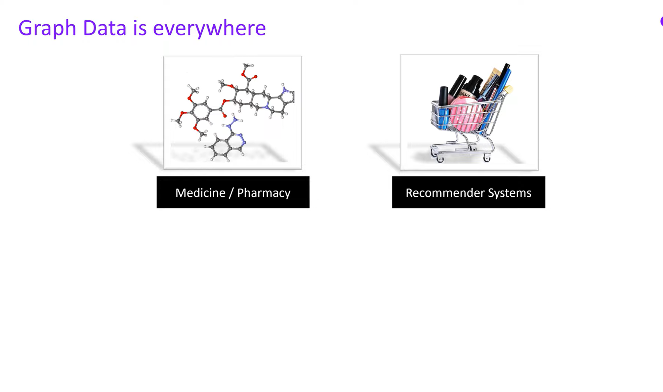
Notes:
02:07 Graph data can be used for note-level predictions and link predictions in machine learning.
Note-level predictions involve inferring attributes or classifying unlabeled nodes using information from other nodes in the graph.
Link predictions involve predicting connections between nodes in a graph, such as predicting customer connections for companies.

Slide 5
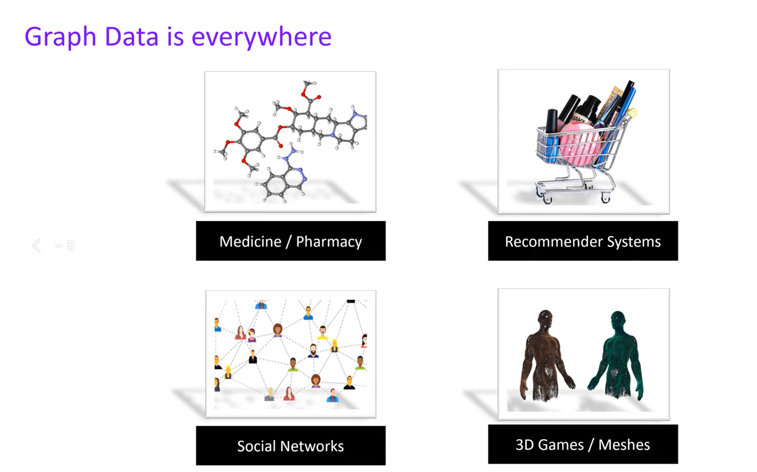
Notes:
02:07 Graph data can be used for note-level predictions and link predictions in machine learning.
Note-level predictions involve inferring attributes or classifying unlabeled nodes using information from other nodes in the graph.
Link predictions involve predicting connections between nodes in a graph, such as predicting customer connections for companies.

Slide 6
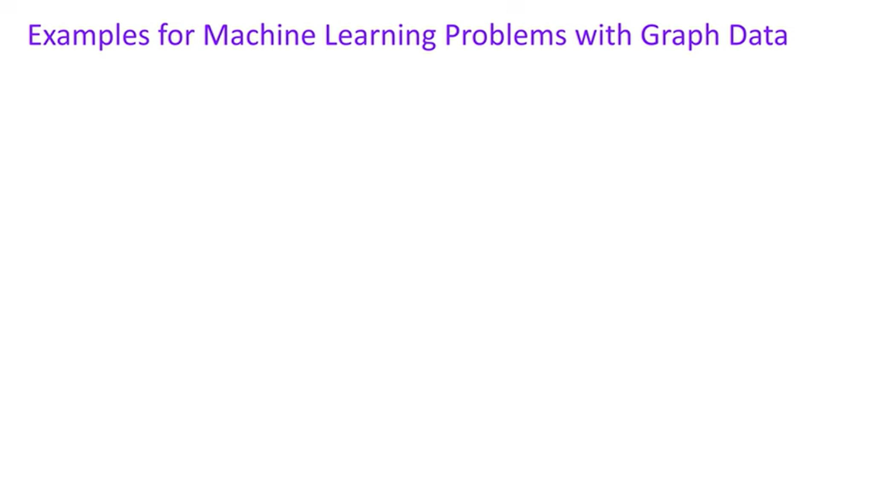
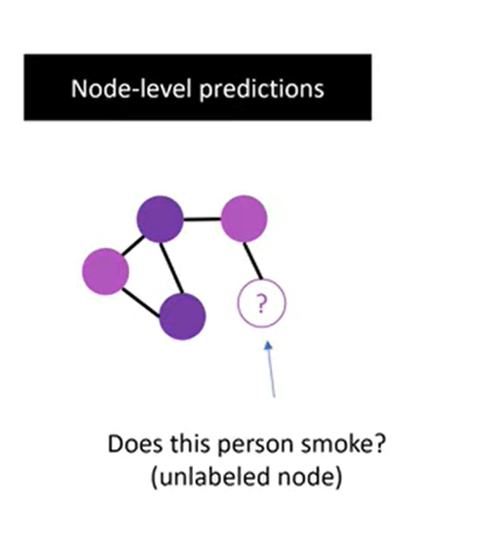
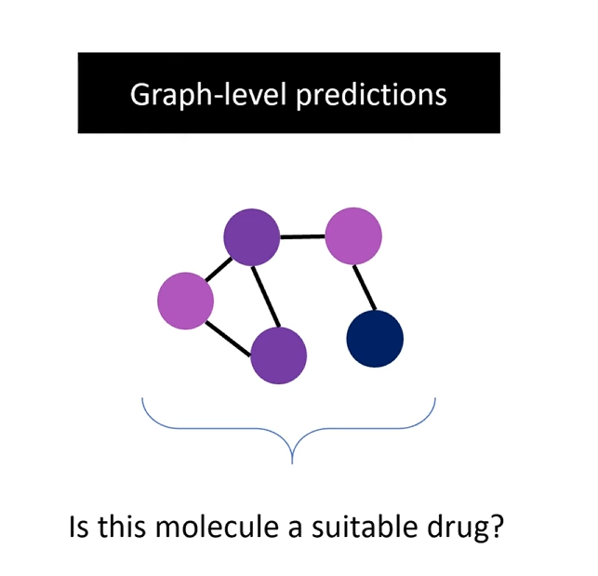
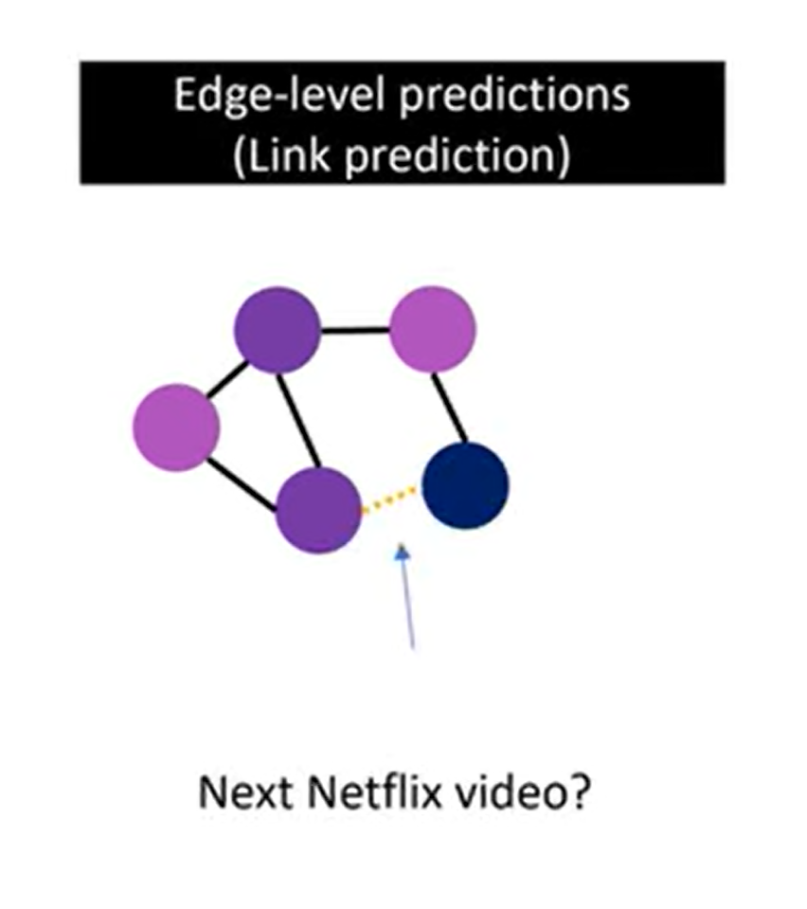
Notes:
02:07 Graph data can be used for note-level predictions and link predictions in machine learning. Note-level predictions involve inferring attributes or classifying unlabeled nodes using information from other nodes in the graph.
Link predictions involve predicting connections between nodes in a graph, such as predicting customer connections for companies.
03:10 Graph data poses difficulties due to its dynamic size and shape.
Graph Neural Networks (GNNs) extend classical feed-forward models to handle graph data.
GNNs cope with the varying size and shape of graph data, making it suitable for tasks like drug identification.

Slide 7

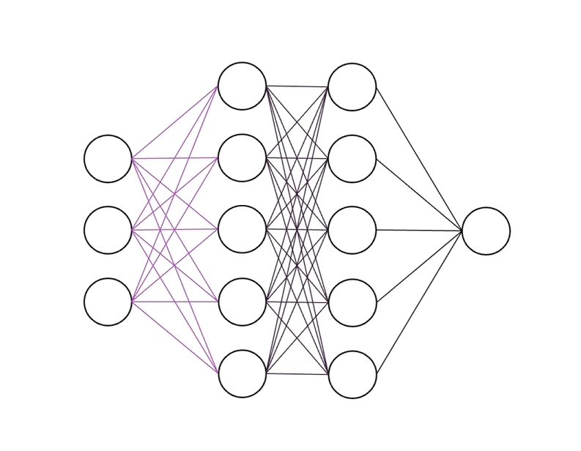
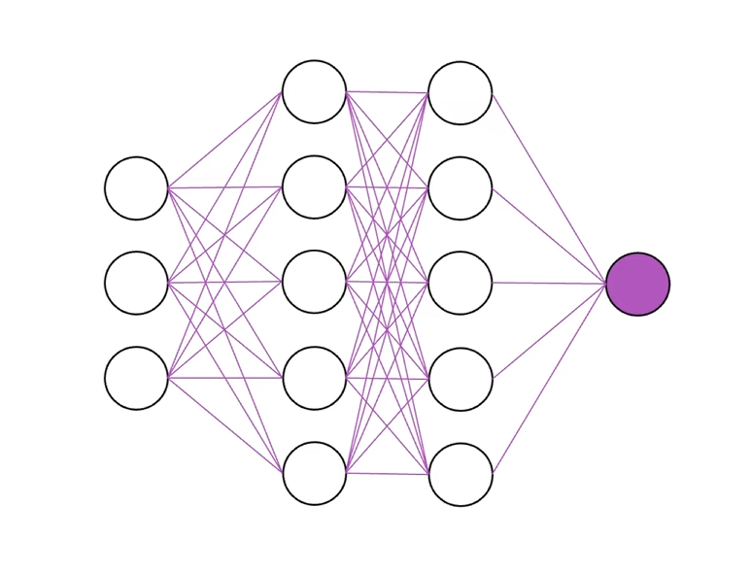
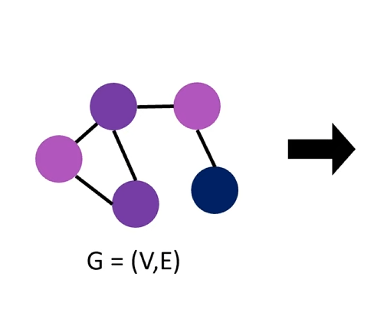
Notes:
03:10 Graph data poses difficulties due to its dynamic size and shape.
Graph Neural Networks (GNNs) extend classical feed-forward models to handle graph data.
GNNs cope with the varying size and shape of graph data, making it suitable for tasks like drug identification.

Slide 8
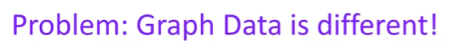
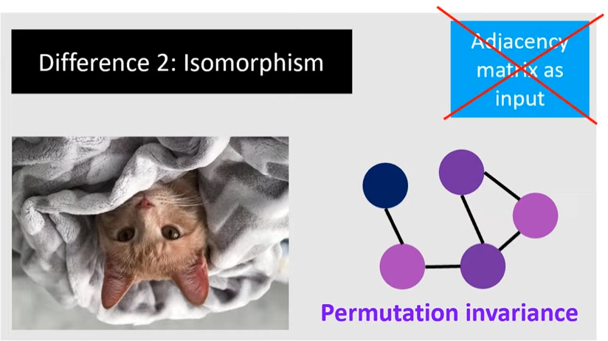
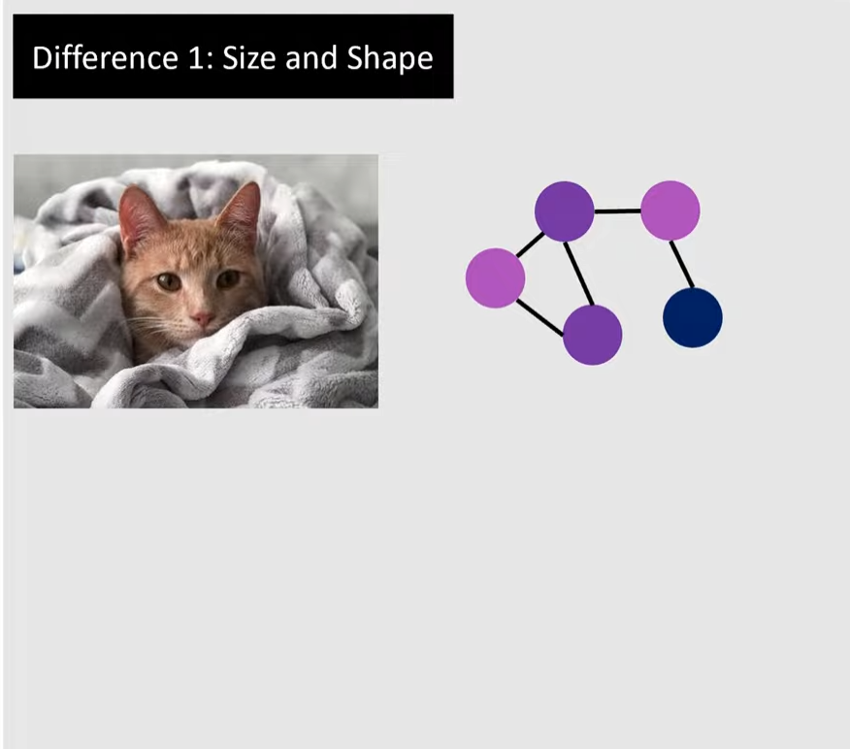
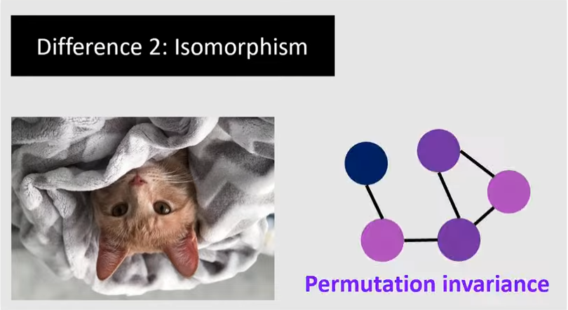
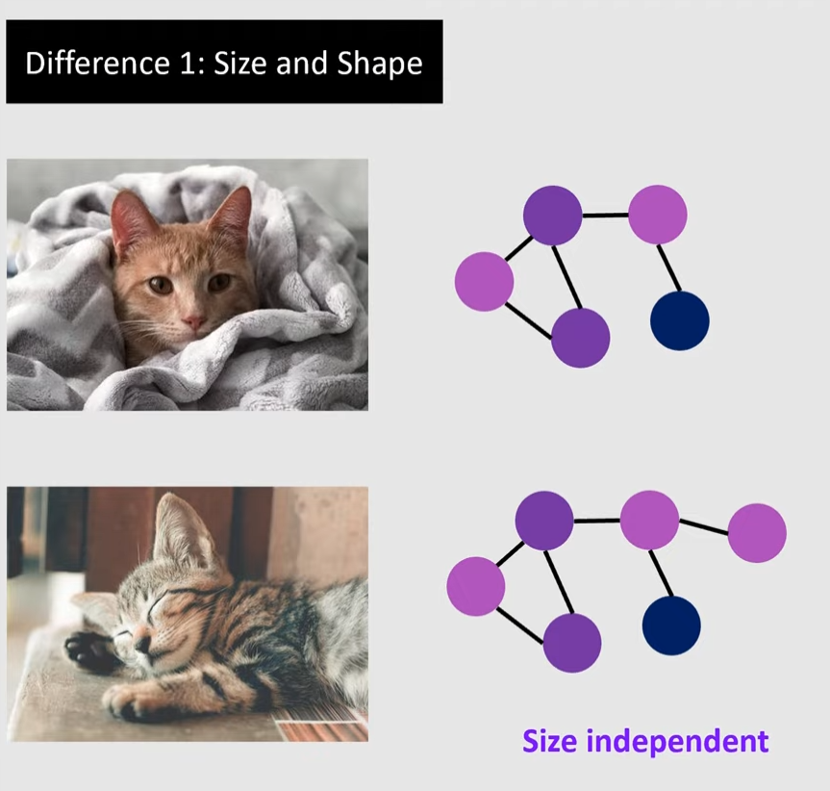
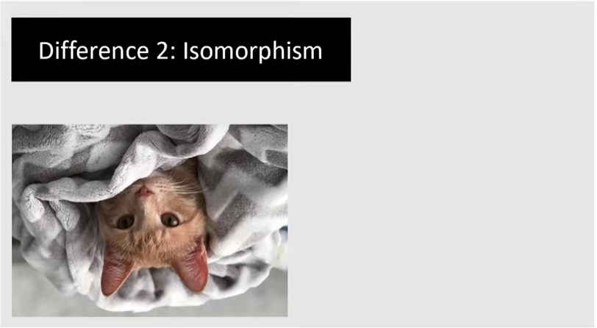
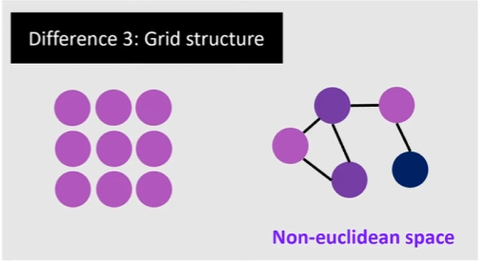
Notes:
04:11 Handling arbitrary input shapes, isomorphism, and non-euclidean structure in graph data.
Resizing, padding, and cropping images do not apply to graph data.
Graph algorithms need to be permutation invariant and not sensitive to changes in node order.
05:13 The fundamental idea of GNNs is to learn a suitable representation of graph data.
GNNs incorporate the edge information between nodes to define space and distance metrics.
GNNs use all the information about the graph, including node features and connections stored in an adjacency matrix, to generate node embeddings that contain structural and feature information of other nodes.

Slide 9
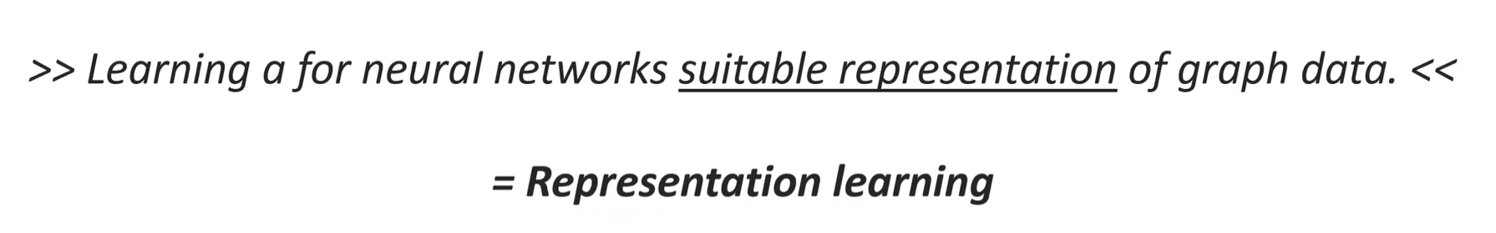
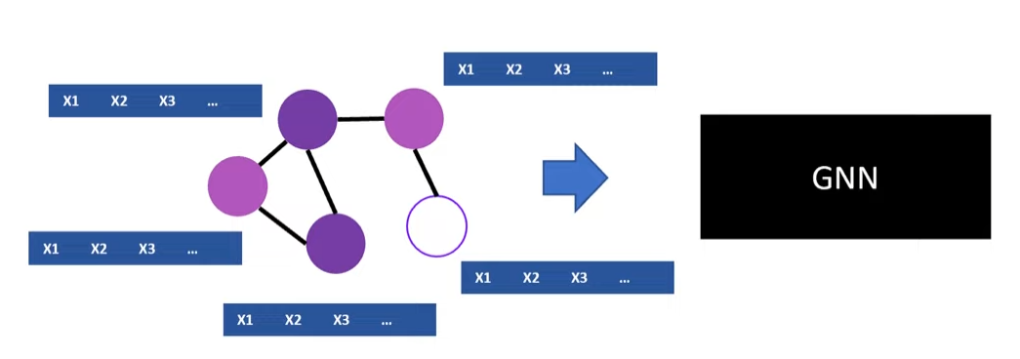
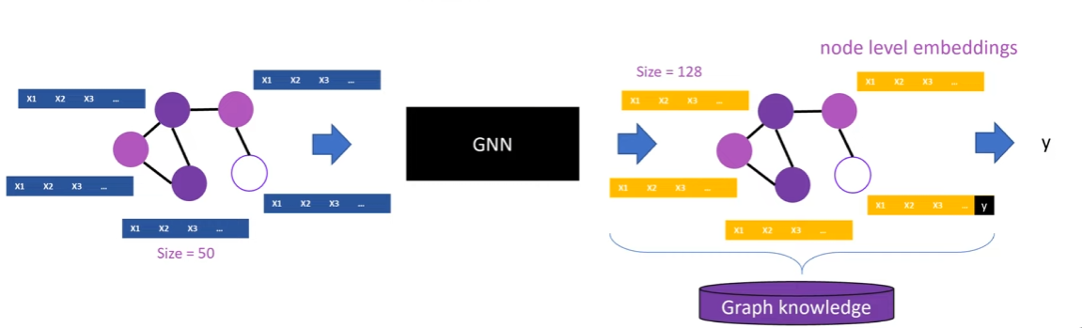
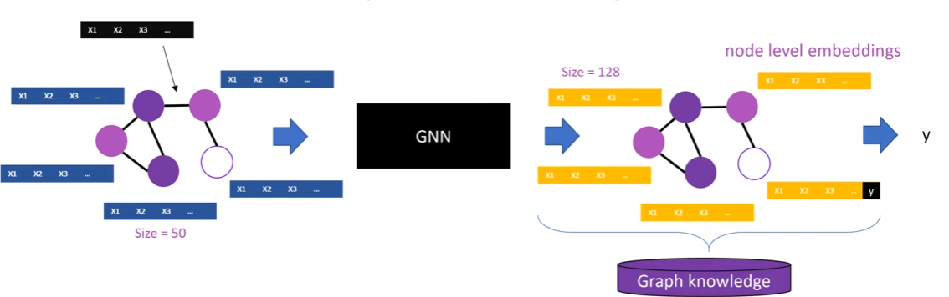
Notes:
06:17 Graph Neural Networks can be used for node-level predictions as well as graph-level predictions.
For node-level predictions, the node embedding of a specific unlabeled node is used to obtain a prediction.
For graph-level predictions, all the node embeddings are combined in a certain way to get a representation of the whole graph. Pooling operations can be included to compress the graph into a fixed size vector.
07:19 Graph Neural Networks use node and edge information to create node embeddings.
Node feature vectors contain properties such as atom type and number of protons.
Edge features are also processed and combined into node embeddings.

Slide 10
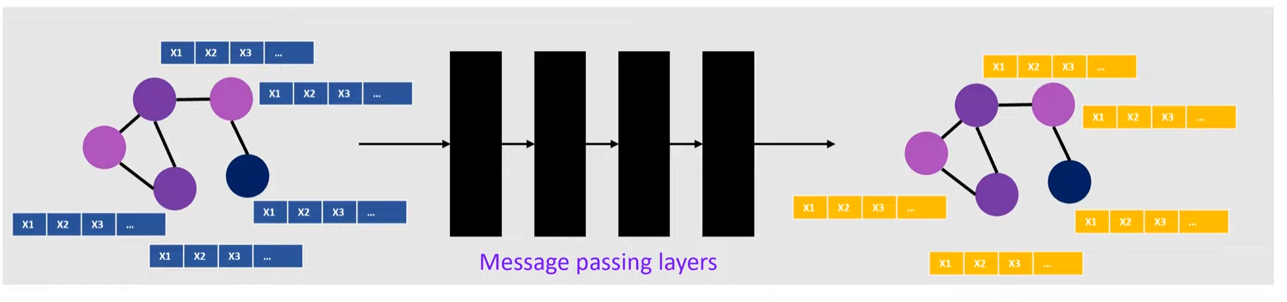
Notes:
Graph Neural Networks use message passing to construct node embeddings and update node features.
Node embeddings contain compressed knowledge about other nodes and edges.
Graph convolutions extend convolutions to graph data.

Slide 11
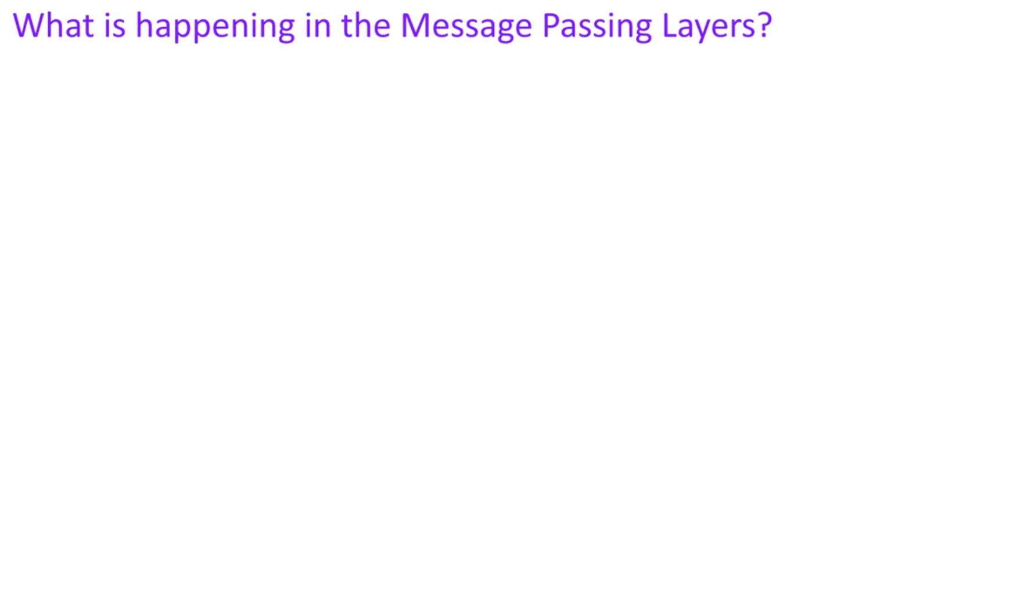
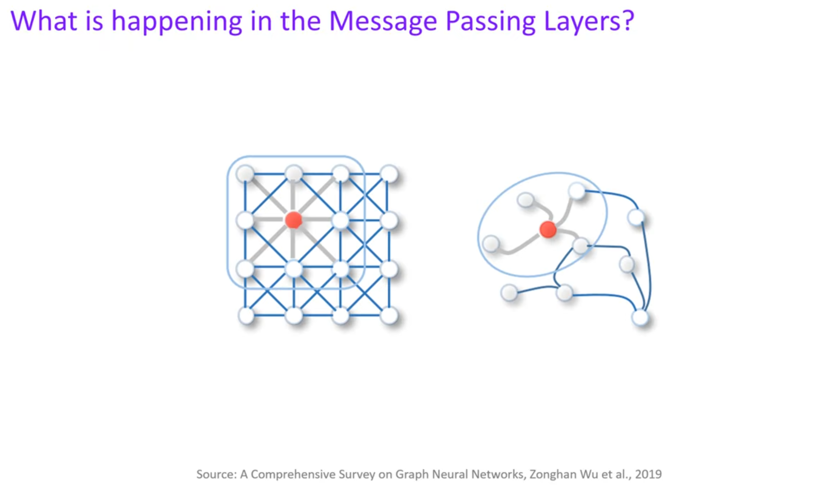
Notes:
Graph Neural Networks use neighborhood information to create new embedding vector
Each node in a graph collects information from its neighboring nodes
This process is called message passing and is done simultaneously for all nodes

Slide 12
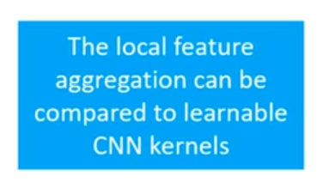
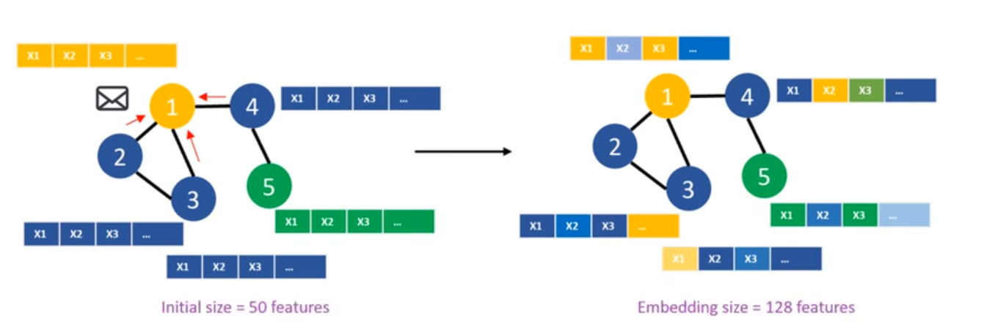
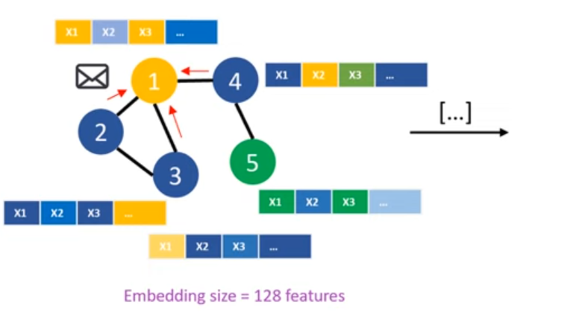
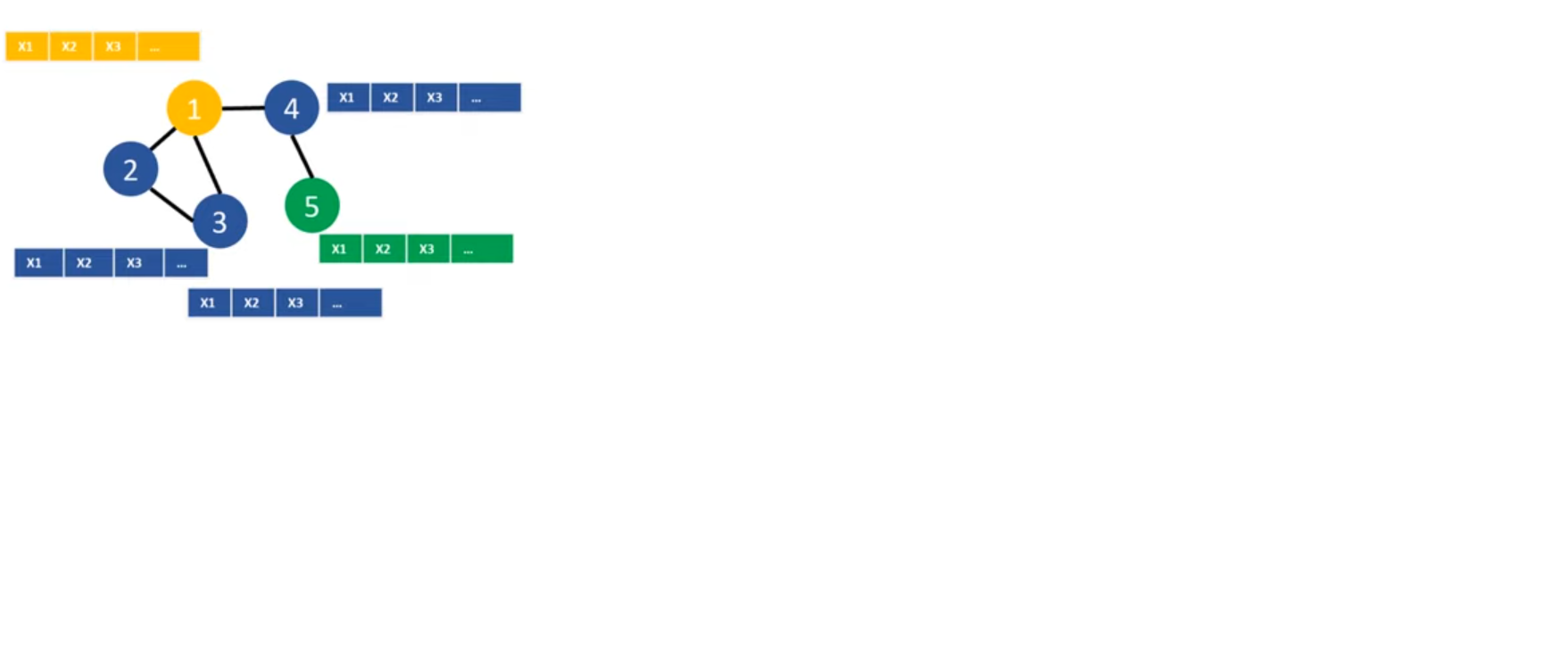
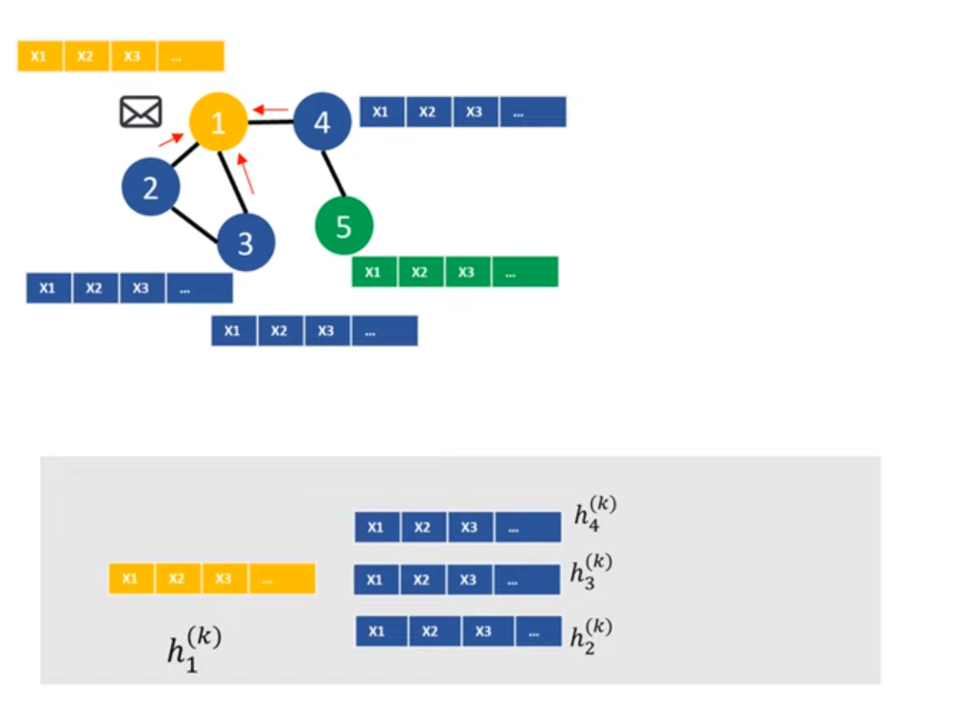
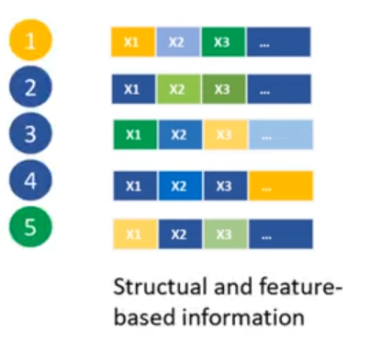
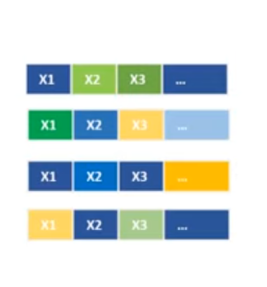
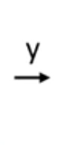
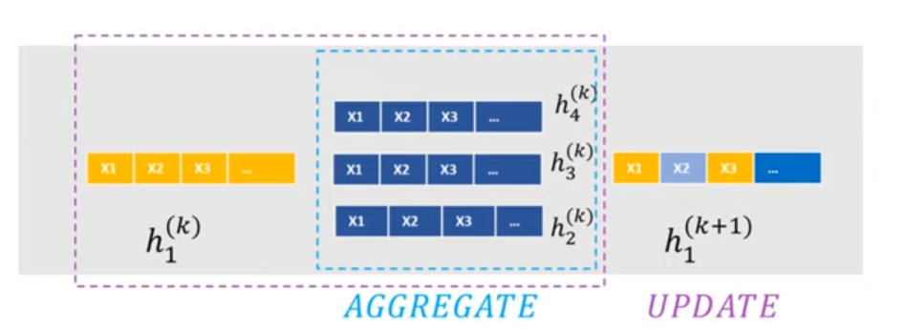
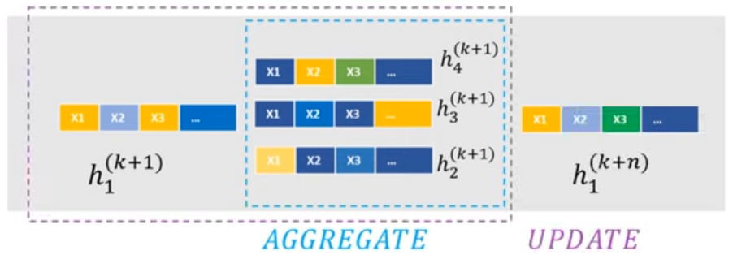
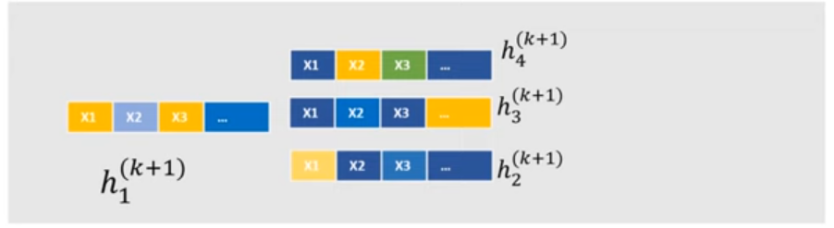
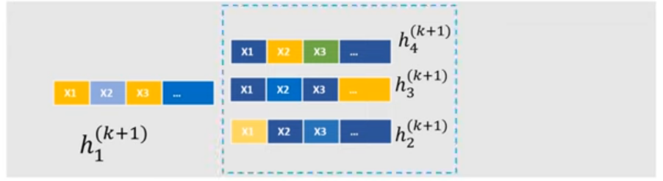
Notes:
Message passing updates node embeddings by combining information from neighbors.
Node states are denoted with h and aggregation is done on neighbor states.
New embeddings are generated for every node in the graph through message passing.

Slide 13
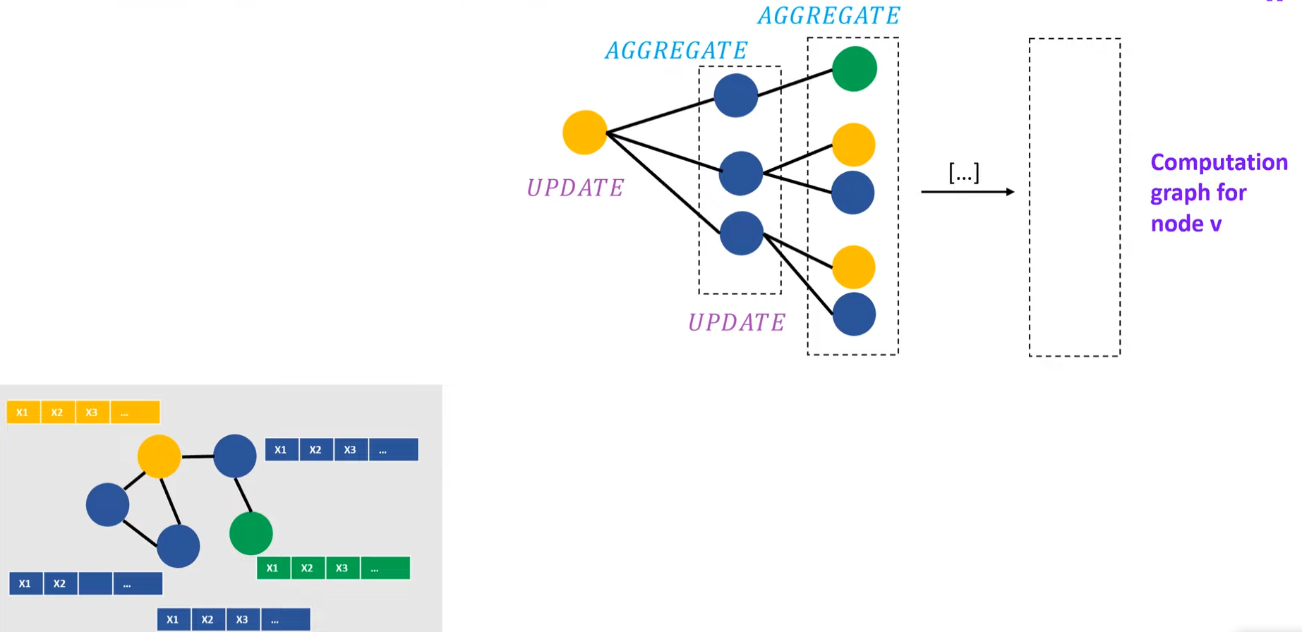
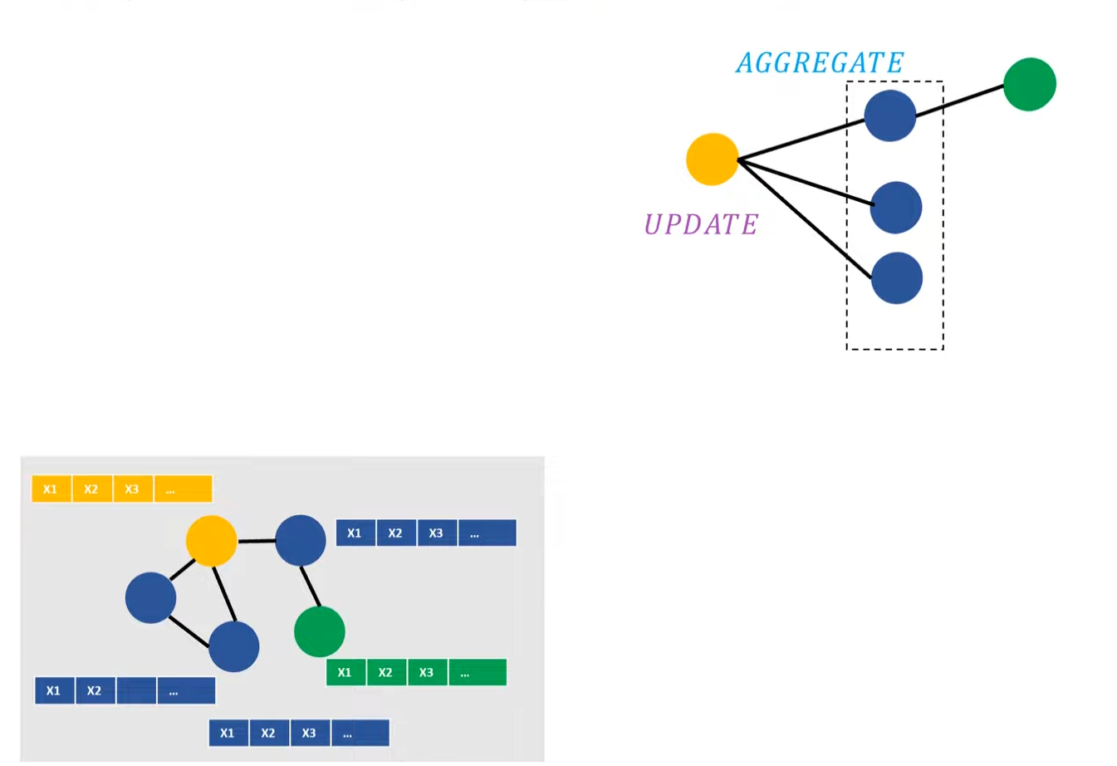
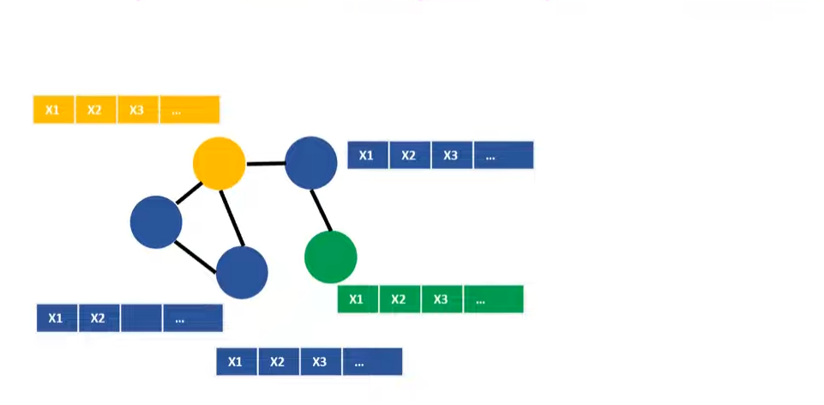
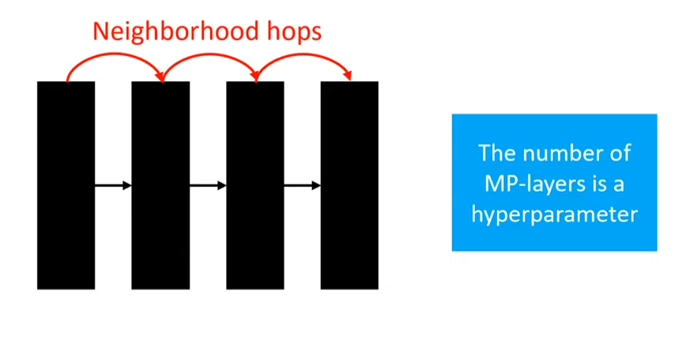
Notes:
Graph Neural Networks (GNNs) learn embeddings by combining node information in a local neighborhood
GNNs update node embeddings using the current node embedding and state messages from its neighbors
Node embeddings in GNNs contain feature-based and structural information about the graph
Graph neural networks can understand the neighbors and neighbor neighbors of each node.
By visualizing the computation graph, we can see which nodes are the direct neighbors of a specific node.
The number of layers in a GNN determines how many neighborhood hops are performed.

Slide 14
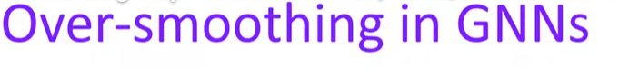
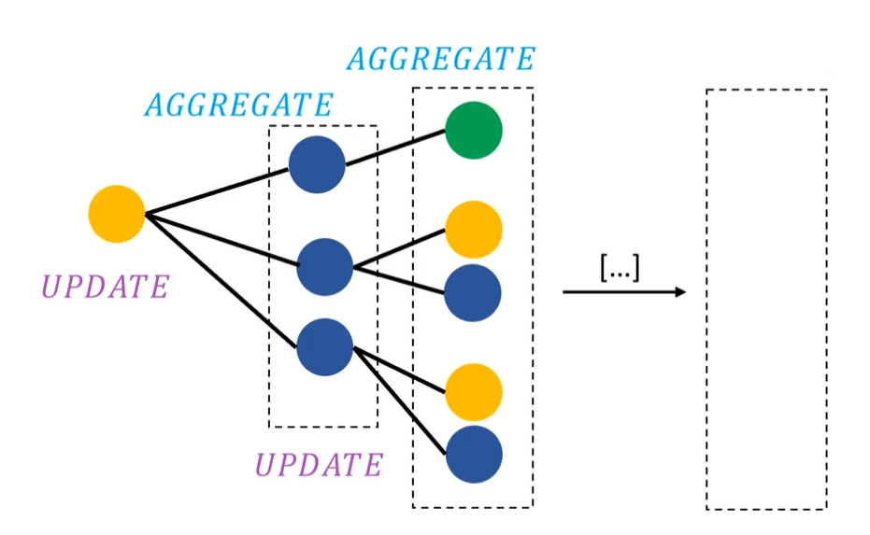
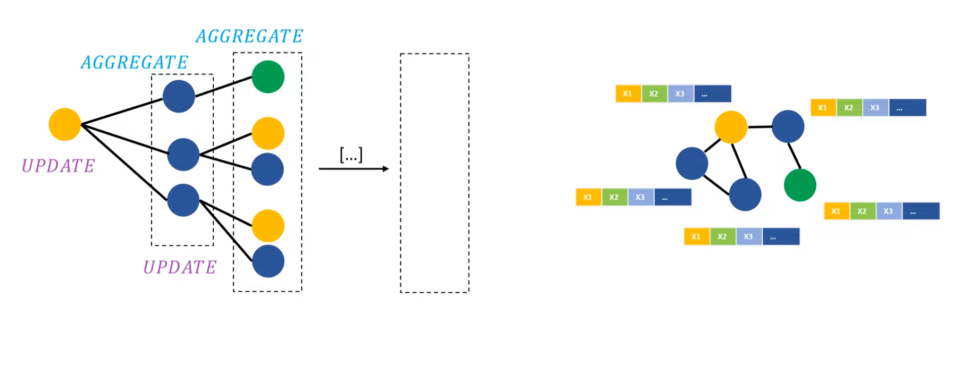
Notes:
Over-smoothing can occur when too many message passing layers are stacked in a GNN.
The node embeddings contain most of the information after the second layer.
Continuously combining these states over many more layers can make all node states indistinguishable from each other.

Slide 15
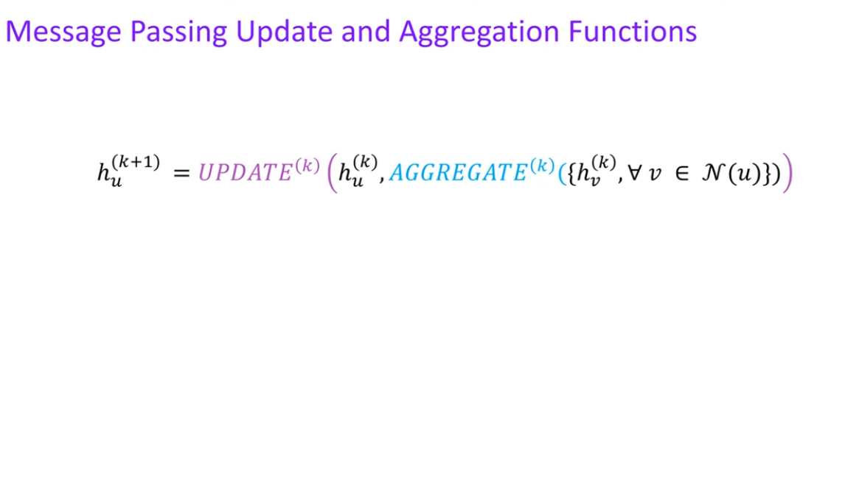
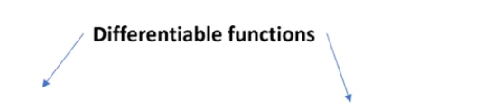



Notes:
07:10 Combining neighbor states and yellow node state to get a new embedding for the yellow node.
Different variants of message passing graph neural networks use the same basic formula.
Various operations like mean, max, recurrent neural networks have been used for update and aggregation functions.

Slide 16


Notes:
Variants of Graph Neural Networks
Work using multi-layer perceptrons for aggregate operation with learnable weights.
Popular paper applied attention mechanism to consider importance of neighbor features for aggregation.

Slide 17

GCN
Graph Convolutional Networks

Slide 18
Why We Need GCNs
Grid Data (Euclidean) | Graph Data (Non-Euclidean)
What is it? | What is it?
Data with a highly regular, grid-like structure. | Data defined by irregular connections and relationships.
Examples: | Examples:
1. Images: A 2D grid of pixels. | 1. Social Networks: Users connected by friendships.
2. Text: A 1D sequence of words. | 2. Molecules: Atoms connected by chemical bonds.
3. Audio: A 1D sequence of sound samples. | 3. Internet: Web pages connected by hyperlinks.
How do we process it? | How do we process it?
We have amazing tools for this! | Our old tools fail...
Convolutional Neural Nets (CNNs) are masters of 2D grids. | A CNN can't handle this!
Recurrent Neural Nets (RNNs) handle 1D sequences.

Slide 19


Adjacency (A) and feature matrix (X)
The Goal of a GCN: Combine the structure (A) and features (X) to make smarter predictions.

Slide 20
The Core Idea: Neighborhood Aggregation
CNN (For Images) | GCN (For Graphs)
A CNN filter (a 3x3 kernel) slides over the image. | A GCN "filter" operates on a node.
To understand one pixel, it looks at its fixed 3x3 neighborhood. | To understand one node, it looks at its irregular neighbors.
A GCN layer updates every node in the graph.
To update a node, it "looks" at all of its direct neighbors.
It "pulls" the feature vectors from all those neighbors.
It "aggregates" them (e.g., by summing or averaging) to create a single "neighborhood" vector.
This new vector summarizes the node's entire neighborhood!
A node's new features are the average of its neighbors' features.
How can we do this "neighborhood pull" for all nodes at the same time?

Slide 21
Answer - By Matrix Multiplication?

Slide 22

A First Attempt (Simple Aggregation)
How can we get the sum of all neighbors' features for every node at once?
Multiply the Adjacency Matrix (A) by the Feature Matrix (X).
This is great! But... it gives us two big problems.

Slide 23

Two Problems and Their Fixes

Slide 24

Two Problems and Their Fixes

Slide 25

The Solution: Symmetric Normalization

Slide 26

The Solution: Symmetric Normalization

Slide 27


Slide 28



The Full GCN Layer Formula

Slide 29
Stacking Layers (What Makes it "Deep"?)

Slide 30


Stacking Layers (What Makes it "Deep"?)

Slide 31


Slide 32

CNN VS GCN

Slide 33

CNN VS GCN

Slide 34

CNN VS GCN

Slide 35

Convolution in GCN: The Two Families

Slide 36


Slide 37


Slide 38

(Feature Refinement)
(Down-sampling)

Slide 39

The convolutional part

Slide 40

2
Before convolution: The graph's inputs consist of the Vertex Features (H), which are the initial properties of each atom (like electron density), and the Adjacency Matrix (A), representing the fixed chemical bonds.
During convolution: The GCN layer uses the Adjacency Matrix (A) to guide the aggregation of features; specifically, a central atom combines its features with those of all its directly bonded neighbors, allowing it to learn about its local chemical environment.
After convolution: The Filtered Vertex H^{l+1} features are updated and enriched by these neighboring influences, but the chemical bonds (structure) remain fixed and unchanged.

Slide 41

The pooling part

Slide 42

Before Pooling: The input is a large, heterogeneous graph (many individual nodes/users) where dense communities/clusters (e.g., 'Sports Fans') can be identified based on connections and features.
GNN Pooling Layer:The layer processes the graph to reduce its size by learning to group or cluster highly connected and similar individual nodes.
After Pooling (The Transformation):
Node Reduction: Each original community is compressed into a single "Super-Node." The total number of nodes is significantly reduced.
Structure Transformation: The original connections (edges) are replaced by new connections between the Super-Nodes.
Result: The output is a smaller, coarser graph that retains the hierarchical information of the original.

Slide 43


Slide 44


Slide 45


Slide 46
Real-World Applications
1. Node Classification | 2. Graph Classification | 3. Link Prediction
The Question: "What group does this node belong to?" | The Question: "What property does this entire graph have?" | The Question: "Are these two nodes likely to be connected?"
How: We use a node's final embedding to predict its label. | How: We pool all node embeddings to get one vector for the whole graph, then predict a label for it. | How: We compare the embeddings of two nodes to see how likely a link is.
Examples: • Social Networks: Predicting if a user is a bot or a real person. • Citation Networks: Classifying a research paper's topic (e.g., "Physics," "AI") based on what it cites. | Examples: • Drug Discovery: Predicting if a molecule (a graph) is toxic or will be a good drug. • Computer Vision: Classifying 3D point clouds. | Examples: • Recommender Systems: "Will this user like this product?" • Social Networks: Recommending new friends.

Slide 47

Conclusion

Slide 48
Thanks a lot for listening! Hope we contributed in enhancing your knowledge!

Slide 49
Contribution Table
Roll Number | Name | %Contribution
2511AI42 | Anurag Chandel | 4.54%
2511AI35 | Akshay K | 4.54%
2511CS12 | Abdul Kayum | 4.54%
2511AI19 | Piyush Kumar | 4.54%
2511AI28 | Piyush Poonia | 4.54%
2511AI03 | Sanand Tripathi | 4.54%
2511AI15 | Chetan Singh | 4.54%
2511AI20 | Vaibhav Singh | 4.54%
2511CS15 | Ayush Dutt | 4.54%
2511AI24 | Karan | 4.54%
2511AI55 | Lalisha Lilhore | 4.54%
2511AI02 | Girisha | 4.54%
Roll Number | Name | % Contribution
2511CS11 | Arvind Kumar | 4.54%
2511AI63 | Utkarsh Pandey | 4.54%
2511CS06 | Abdul Khazmuddin | 4.54%
2511AI04 | Abhyudaya Yadav | 4.54%
2511CS20 | Tarun Vijay | 4.54%
2511AI41 | Konapala Tarakananda | 4.54%
2511CS14 | Sasikumar R | 4.54%
2511AI60 | Mansi Vashistha | 4.54%
2511AI46 | Samyaka Bhavsagar | 4.54%
2511AI61 | Ayanava Dutta | 4.54%

